Slide 1
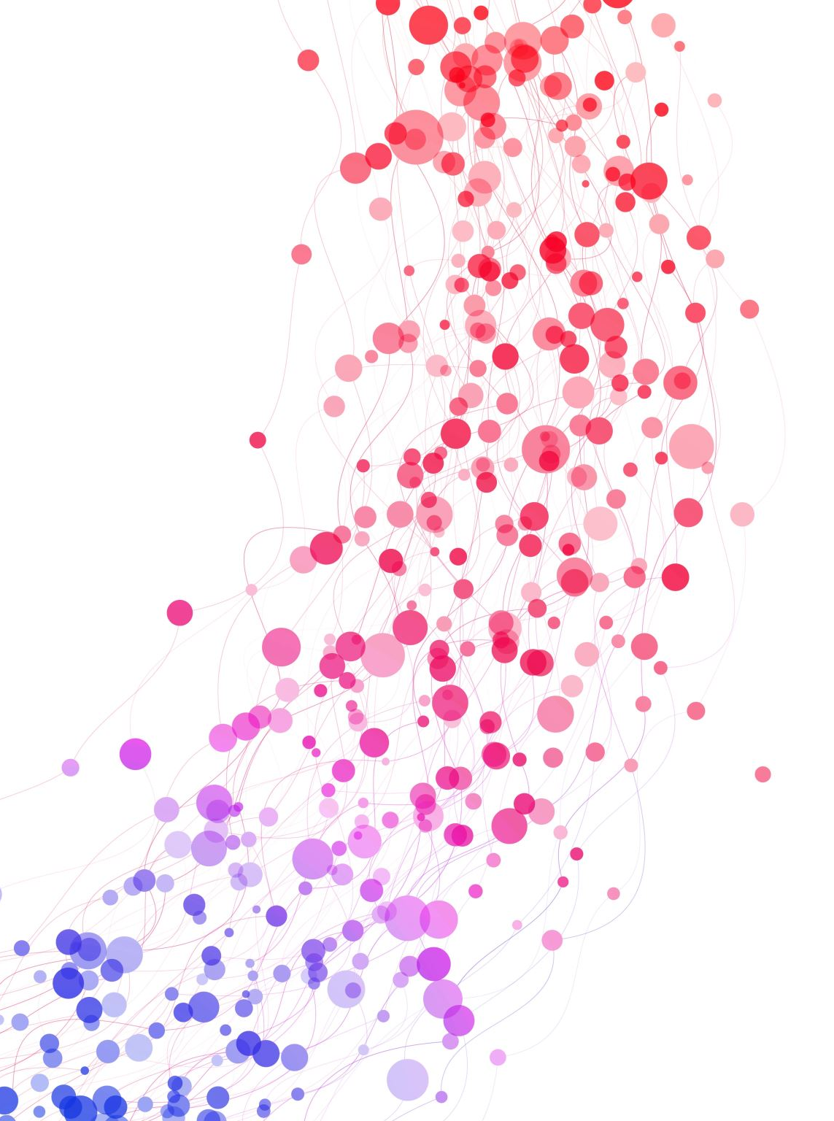
Let’s build a search engine: Exploring the past with Natural Language Processing
Peter Nadel
Digital Humanities Natural Language Processing Specialist​
Research Technology, TTS

Slide 2
What is a search engine
We’re all used to tools like Google or JumboSearch but how do they actually work?
Information retrieval: Understand a user query and check it against documents in a corpus quickly and efficiently

Slide 3
What is a search engine
Key components:
An index – like a book’s index but for all of the documents in a collection
A query processor – a tool that understands language and know what you’re looking for
A ranking system – something that determines what documents are most relevant to your query

Slide 4
Indexing
Indexing happens before any searching begins
The index is what we will search through to get our documents
Breaks down each into individual words (tokenization)
Records where each word appears
Creates signposts for each word’s location
Very similar to creating finding aids in an archive

Slide 5
Indexing
The indexer prepares documents in a couple steps:
Normalization: Converting words with the same meaning to the same form (“Theatre” and “Theater”)
Stemming: Recognizing certain words are related to each other ( “runs” and “ran” are both forms of “run”)
Stop words: Filtering out very common (“The” and “This”)
What kinds of text does this work best for? What kinds of text does this not work for? How about other languages?

Slide 6
Querying
What happens when you type into a search bar
The search engine processes your search in the same way it processed the documents
Critical that it is the same way
Need to be comparing like to like
Looks up processed terms in the index
Finds all documents containing these terms

Slide 7
Ranking
Once a search engine has found documents related to the query, how does it rank them?
Want a ranking system that gives us the most relevant result first
So far our index only tells us where words occur
No measure of relevancy yet
We need a method that automates this relevancy quickly and efficiently

Slide 8
Ranking
Term Frequency - How often does the word appear?
More mentions is a topic is more relevant than other documents
Is this assumption always true?
Inverse document frequency – How unique is this word across all documents?
Common words appear everywhere, so they’ll be less useful
Rare terms will likely be more meaningful
Combined score: TF-IDF

Slide 9
Ranking
Term frequency-Inverse document frequency (TF-IDF)
Goal: Balance how often a term appears with how distinctive it is
Helps find documents that are strongly focused on search terms
Prioritizes sources that both frequently discuss the topic and provide new context
But how can we use it?

Slide 10
TF-IDF Example
Here is our corpus:
First document: “Call me Ishmael.”
Second document: “I am an invisible man.”
Third document: “Mother died today. Or maybe, yesterday; I can't be sure”
Fourth document: “All this happened, more or less.”
We are going to:
Normalize
Stem
Use TF-IDF to create a tool to rank texts

Slide 11
Example: Normalization
Normalization, in this case, will just consist of lower-casing and removing punctuation:
First document: “call me ishmael”
Second document: “i am an invisible man”
Third document: “mother died today or maybe yesterday i cant be sure”
Fourth document: “all this happened more or less”

Slide 12
Example: Stemming
When we stem, we will turn all words into their base forms:
First document: “call i ishmael”
Second document: “i be a invisible man”
Third document: “mother die today or maybe yesterday i cant be sure”
Fourth document: “all this happen more or less”

Slide 13
Example: TF-IDF
Now we can make a document term matrix (DTM) out of our documents using TF-IDF
First, we will just do term frequency
Need to make a spreadsheet where each column is a unique word from all of our documents and each row is a document

Slide 14
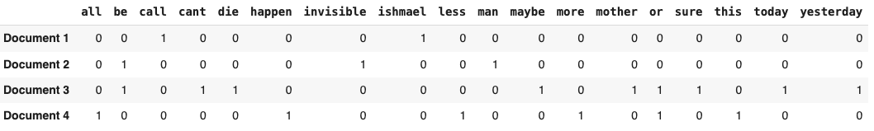
Example: Term frequency

Slide 15
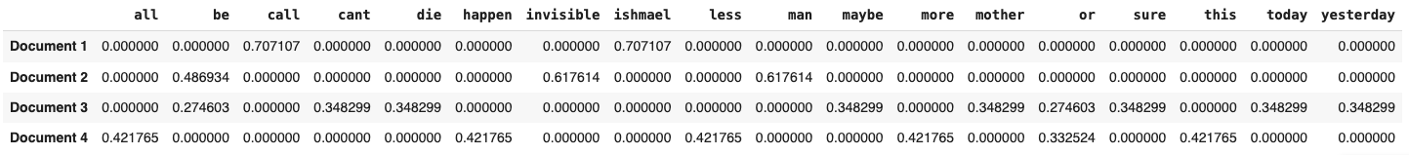
Example: Document Term Matrix

Slide 16
Example: Querying
Now that we have a document term matrix, we can create a query and rank the document accordingly
First we need to normalize it and stem it like we did to the documents
Then we need to create a single row like this query is a new document
Last we will take the dot product of each document row and this query row to get a single number for each

Slide 17
Example: Query row
Our example query will be “invisible man”
We can now compare this query row to all of the other rows with a simple matrix: the dot product.
Take the product of corresponding elements
Sum all of these together
Rank documents by the result

Slide 18
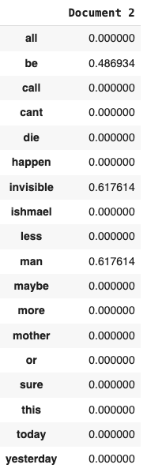
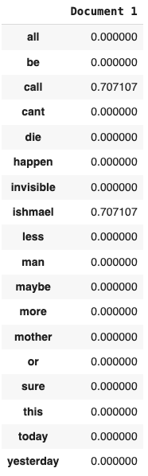
Example: Ranking
For ‘all’: 0 * 0 = 0
For ‘be’: 0 * 0 = 0
For ‘call’: .7 * 0 = 0
For ‘cant’: 0 * 0 = 0
For ‘die’: 0 * 0 = 0
For ‘happen’: 0 * 0 = 0
For ‘invisible’: 0 * .7 = 0
For ‘ishmael’: .7 * 0 = 0
For ‘less’: 0 * 0 = 0
For ‘man’: 0 * .7 = 0
For ‘maybe’: 0 * 0 = 0
For ‘more’: 0 * 0 = 0
For ‘mother’: 0 * 0 = 0
For ‘or’: 0 * 0 = 0
For ‘sure’: 0 * 0 = 0
For ‘this’: 0 * 0 = 0
For ‘today’: 0 * 0 = 0
For ‘yesterday’: 0 * 0 = 0
0 + 0 + 0 … = 0, so we can say that this query has no relevancy to document 1.

Slide 19
Example: Ranking
For ‘all’: 0 * 0 = 0
For ‘be’: .49 * 0 = 0
For ‘call’: 0 * 0 = 0
For ‘cant’: 0 * 0 = 0
For ‘die’: 0 * 0 = 0
For ‘happen’: 0 * 0 = 0
For ‘invisible’: .62 * .7 = 0
For ‘ishmael’: 0 * 0 = 0
For ‘less’: 0 * 0 = 0
For ‘man’: .62 * .7 = 0
For ‘maybe’: 0 * 0 = 0
For ‘more’: 0 * 0 = 0
For ‘mother’: 0 * 0 = 0
For ‘or’: 0 * 0 = 0
For ‘sure’: 0 * 0 = 0
For ‘this’: 0 * 0 = 0
For ‘today’: 0 * 0 = 0
For ‘yesterday’: 0 * 0 = 0
(.62 * .7) + (.62 * .7) = .87, so we can say that this query is very relevant to document 2.

Slide 20
Application
I’ve created a simple application that implement these principles: https://search-engine-creator.streamlit.app/
Upload a CSV where each row is a new document
Index your data
Search your data

